Slide 1
Declarative programming with constraints in Python
An introduction to constraint programming
Daniel Brännström

Slide 2
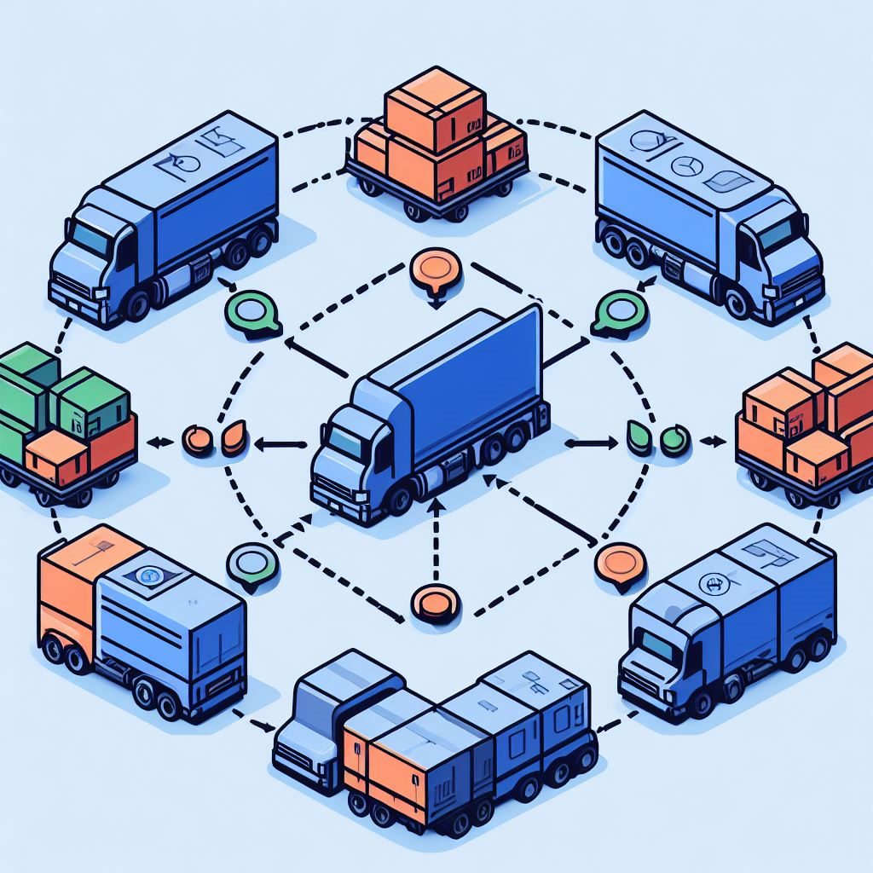
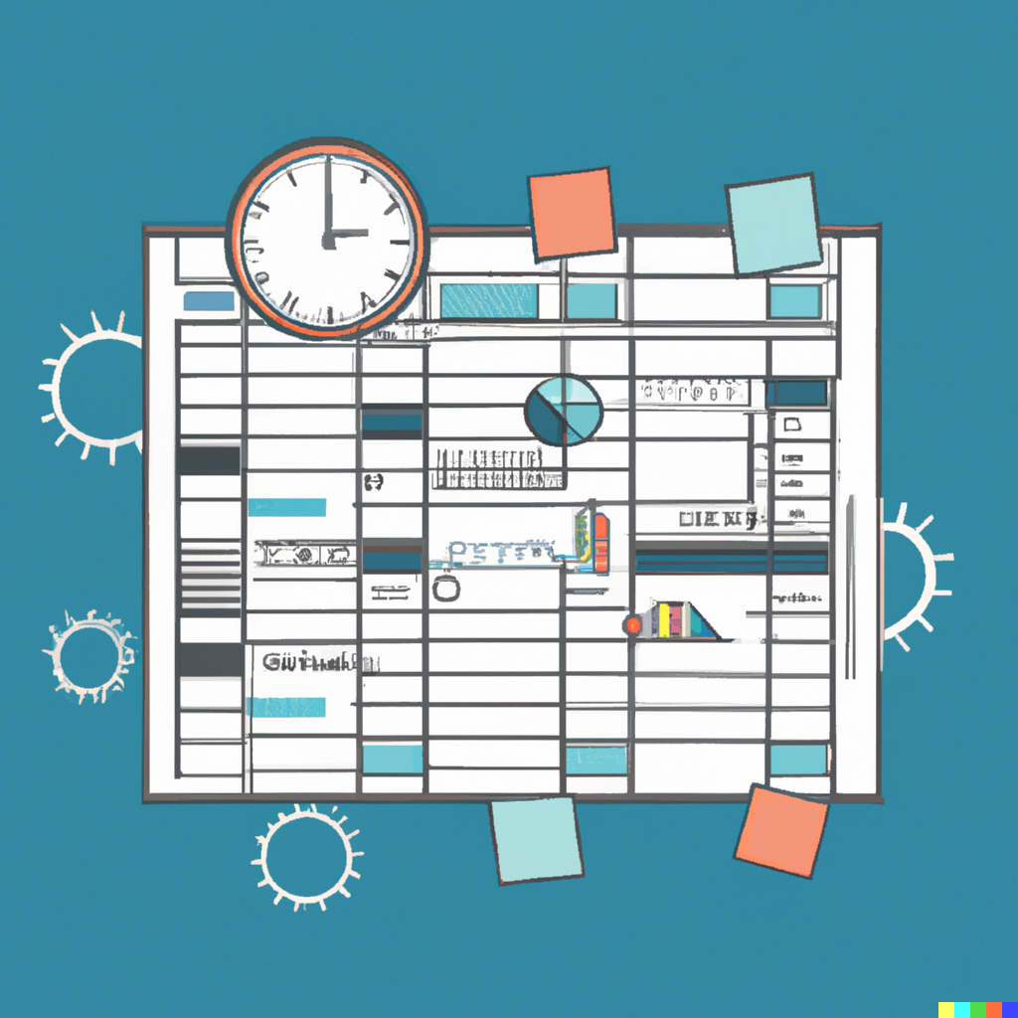

Applications
Resource allocation
Scheduling & Planning
Rule engines
Notes:
https://openrules.com/presentations/BRForum2008.EugeneFreuder.JacobFeldman.pdf
Making a school schedule
A teacher can only hold one lecture at a time and on a selection of subjects
A class of students can only attend one lecture at a time
Students are supposed to take a number of lessons on each subject
Do not start too early and end too late
Time for lunch and breaks
Resource allocation
Bin packing problem
Rule engines
I got interested in cp when working on a credit evaluation system
In general problems with combinatorial nature often combined with some optimization.

Slide 3
Benefits
Code and effort reuse
Industrial strength libraries of great quality and excellent performance available
Lots of research has gone into the topic
No need to reinvent the wheel
Declarative
Express the problem and not how to solve it
Keeps the code and domain clean

Slide 4
Constraint programming
=
Model + Solver

Slide 5
Variables [Model Concept]
X
Y
Z
apa
bepa
foo
bar

Slide 6
Domains [Model Concept]
X
Y
Z
1..10
apa
0..1
bepa
foo
-100..100
bar
Notes:
Integers only

Slide 7
Constraints [Model Concept]
AllDifferent(X,Y,Z)
OnlyEnforceIf(bepa)
X<Y+Z
apa==bepa
foo > bar*bar

Slide 8


Tooling
Notes:
ORToos:
Industrial strength library from Google
OR-Tools won gold in the international constraint programming competition every year since 2013.
Actively maintained, v9.6 released mars 2023
Can solve many types of problems including constraint programming
The CP solver
Works with integer variables
Supports a lot of different constraints
Supports optimization
Can find one or all solutions
Can be used from C#

Slide 9
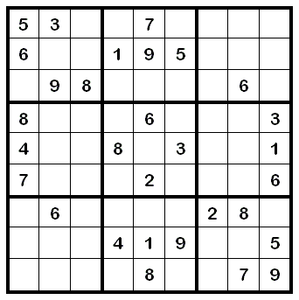
Example: Sudoku
Rules
9x9 cells
Each cell has value 1..9
Some cells are given
The rows, columns and blocks may must not duplicate values
(Only one solution)

Slide 10
Demo
Coding a sudoku solver using OR tools
Notes:
> py -m pip install ortools
> py -m pip install pandas

Slide 11
Concept: Target / Objective
Maximize(X + Y + Z)
Minimize(foo)
Notes:
Constraint satisfaction vs Constraint optimization

Slide 12

Example: Bin packing problem
4000
kg
3000 kg
3000 kg
2000 kg
Capacity: 8000 kg
Capacity: 5000 kg
Notes:
https://github.com/google/or-tools/blob/stable/ortools/sat/samples/bin_packing_sat.py
https://en.wikipedia.org/wiki/Bin_packing_problem

Slide 13
Modelling
 | true/false true if this box is loaded in this truck, false otherwise | …
 | …
4000 kg
3000 kg
3000 kg
2000 kg

Slide 14
Obeservations
Constraint: A box should be loaded in exactly one truck
Constraint: The total box weight must not exceed the truck capacity
Objective: Minimize the number of trucks
Notes:
Use a boolean for each truck to represent if it is used at all. If a truck is not used it must not contain any boxes. (Additional constraint)

Slide 15
Demo
Binpacking solver walkthrough

Slide 16

Constraint Programming ≠ Everyday tool
Notes:
Constraint programming is not an every day development tool such as C#, python, visual studio, sql etc.

Slide 17

Constraint Programming = Specialized tool
Notes:
Specialized tools are not used that often but can be highly efficient when applied to the right task

Slide 18
The future of constraint programming?
People type
Research
Typical CP
application
Problem type
Easy
Hard
Green field CP
application
Engineering

Slide 19
Learn more
OR tools web site https://developers.google.com/optimization
OR tools video https://www.youtube.com/watch?v=AJ6LeiMe_PQ&list=PLAQrMuKVK4aIgDq8nafTAQETvmyeOKOxK&ab_channel=MixedIntegerProgramming
Great stream with lots of examples and usage of OR tools https://www.youtube.com/watch?v=hod0L0zfnZs&t=8618s&ab_channel=JoshuaEckroth
Prolog https://en.wikipedia.org/wiki/Prolog

Slide 20
Thank you!

